Slide 1

ALPHABET Inc.
ANALYSIS OF FINANCIAL STATEMENT YEAR 2021- 2022
By: Swagat

Slide 2
Background
Alphabet Inc. (founded on 2nd Oct. 2015) is an American multinational technology conglomerate holding company headquartered in Mountain View, California.
It is the world's third-largest technology company by revenue and one of the world's most valuable companies.
On August 10, 2015, Google announced plans to create a new public holding company, Alphabet Inc.
Alphabet was created to restructure Google by moving subsidiaries from Google to Alphabet, thus narrowing Google's scope.
Alphabet is currently trading under Google’s former ticker symbols "GOOG" and "GOOGL" with S&P 500 and NASDAQ.
As of 2022 Alphabet stands with a revenue of $282.83 billion.

Slide 3





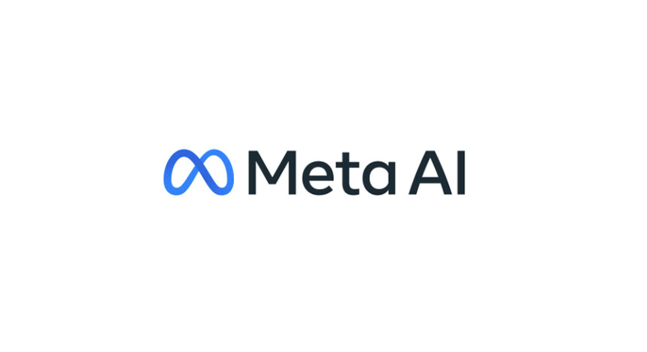
ALPHABET Inc.'s major competitors
This Photo by Unknown author is licensed under CC BY-SA.
This Photo by Unknown author is licensed under CC BY-NC.
This Photo by Unknown author is licensed under CC BY.
This Photo by Unknown author is licensed under CC BY-SA.
This Photo by Unknown author is licensed under CC BY-NC.

Slide 4

ALPHABET Inc.Business model
Alphabet leverages its search, web browsing, mobile operating systems, and cloud computing to make money through the sale of advertising and various service fees.

Slide 5
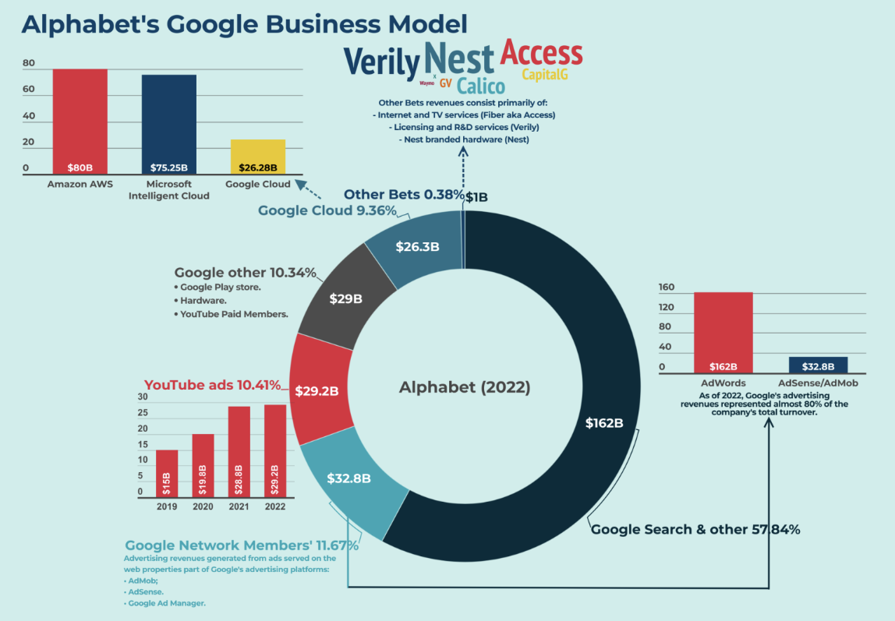

Slide 6
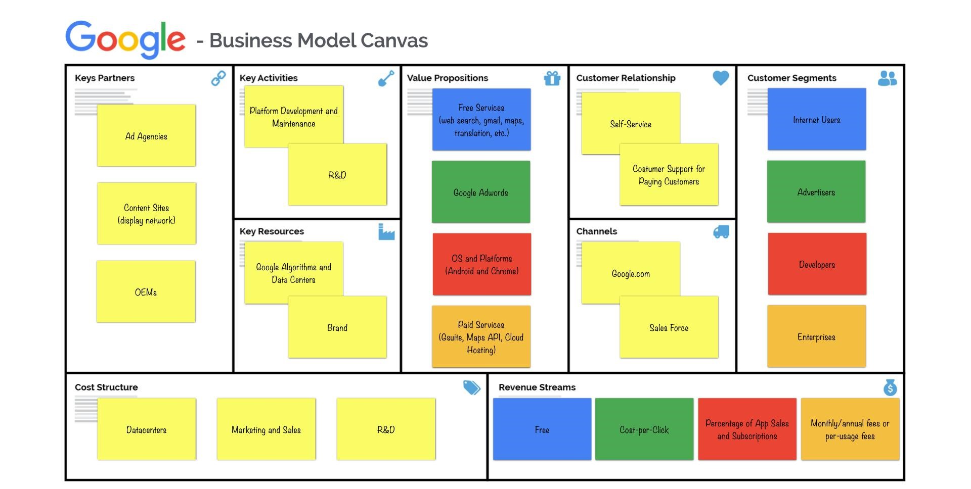

Slide 7

ALPHABET Inc. Is the parent of a diverse set of subsidiaries

Slide 8
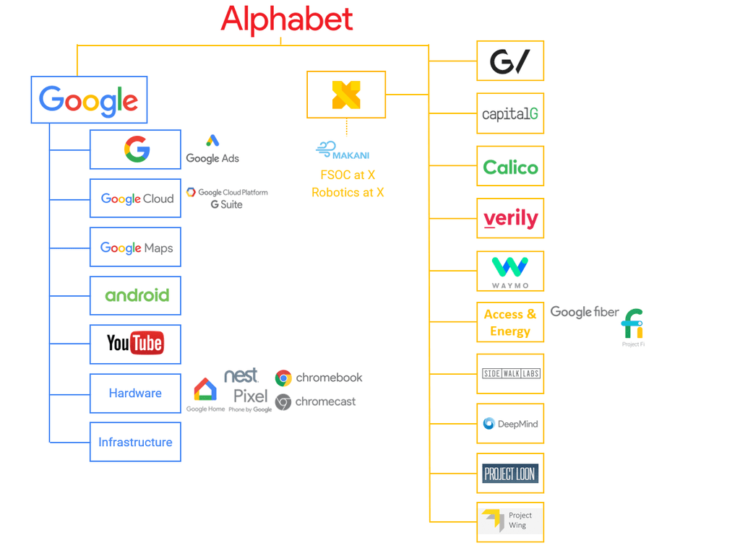

Slide 9
Objectives
Basic horizontal and vertical analysis of the obtained financial statements (Balance sheet and Income statement)
Compare and analyze common-size financial statements.
Preparing financial ratio analysis (Until ROE measure)
ESG rating of your company (Sustainalytics)

Slide 10

ALPHABET Inc. Horizontal analysis – Balance Sheet (2021-2022)

Slide 11
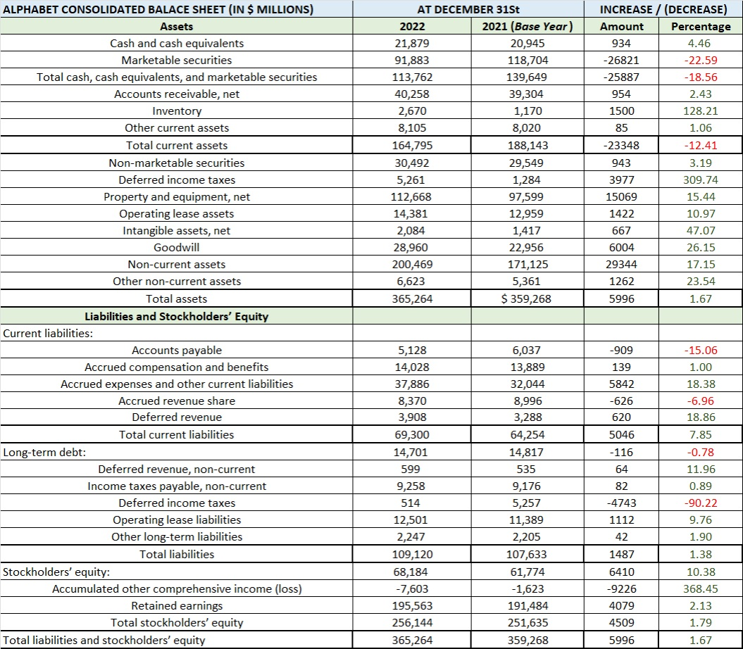

Slide 12

ALPHABET Inc.
Horizontal analysis- Income statement (2021-2022)

Slide 13
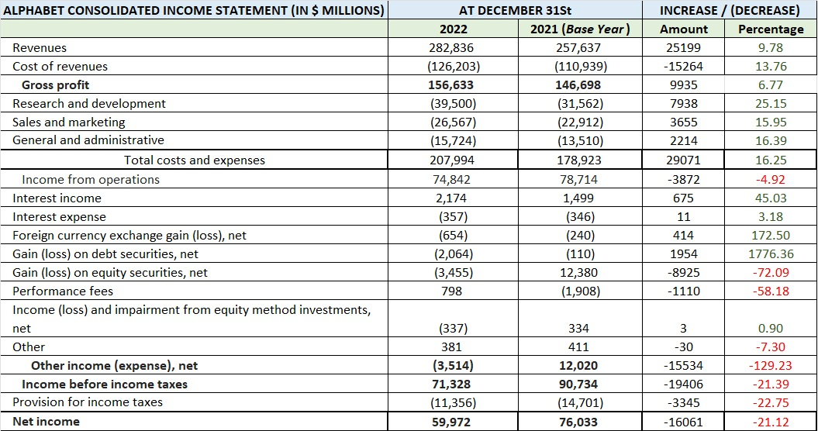

Slide 14

ALPHABET Inc. common-size financial statement

Slide 15
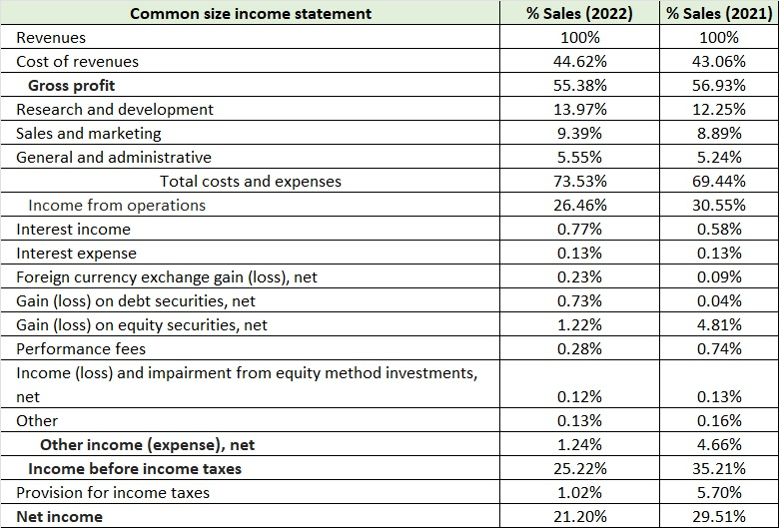

Slide 16

ALPHABET Inc. Common Financial Ratio

Slide 17
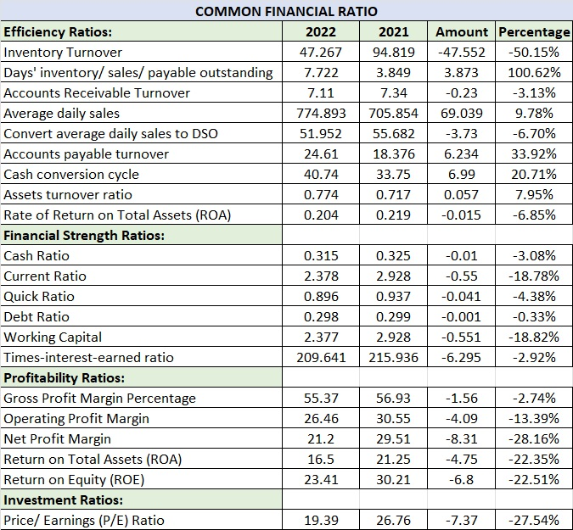

Slide 18

ALPHABET Inc. ESG Rating

Slide 19
Morningstar Vs. Sustainalytics
Focus
Morningstar Rating: Morningstar is a broader financial services company that provides a range of investment research, including fund ratings, stock analysis, and economic research. While they do consider ESG factors, their ratings encompass a wider array of financial metrics. | Sustainalytics Rating: Sustainalytics primarily specializes in environmental, social, and governance (ESG) research and ratings. They evaluate how well companies address ESG risks and opportunities.
Methodology
Morningstar Rating: Morningstar's methodology is not solely focused on ESG criteria. They evaluate various financial factors, including past performance, risk, fees, and management quality. ESG is considered as part of a broader investment analysis. | Sustainalytics Rating: Sustainalytics uses a comprehensive methodology to assess a company's performance across a wide range of ESG criteria. They consider factors such as environmental impact, labor practices, human rights, product safety, governance structure, and more.

Slide 20
Morningstar Vs. Sustainalytics
Scoring System
Morningstar Rating: Morningstar typically provides star ratings for mutual funds and ETFs, with a higher number of stars indicating better historical performance. For stocks, Morningstar may use a similar rating system, considering both financial and ESG factors. | Sustainalytics Rating: Sustainalytics typically provides a numeric ESG score or rating for companies, allowing investors to compare them based on their sustainability and responsible business practices.
Data Sources
Morningstar Rating: Morningstar relies on a combination of company financial reports, market data, and proprietary analysis for its ratings. | Sustainalytics Rating: Sustainalytics relies on a combination of company disclosures, public information, and proprietary research to generate their ESG ratings.

Slide 21
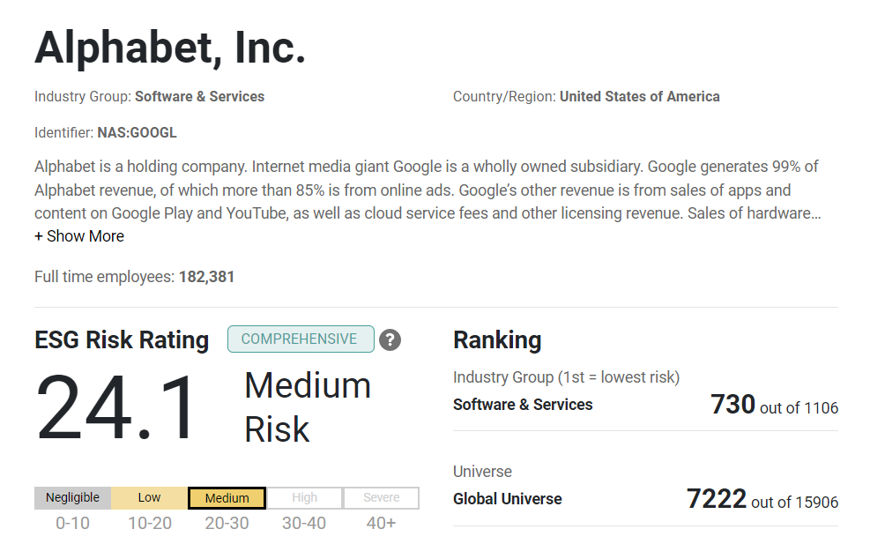

Slide 22

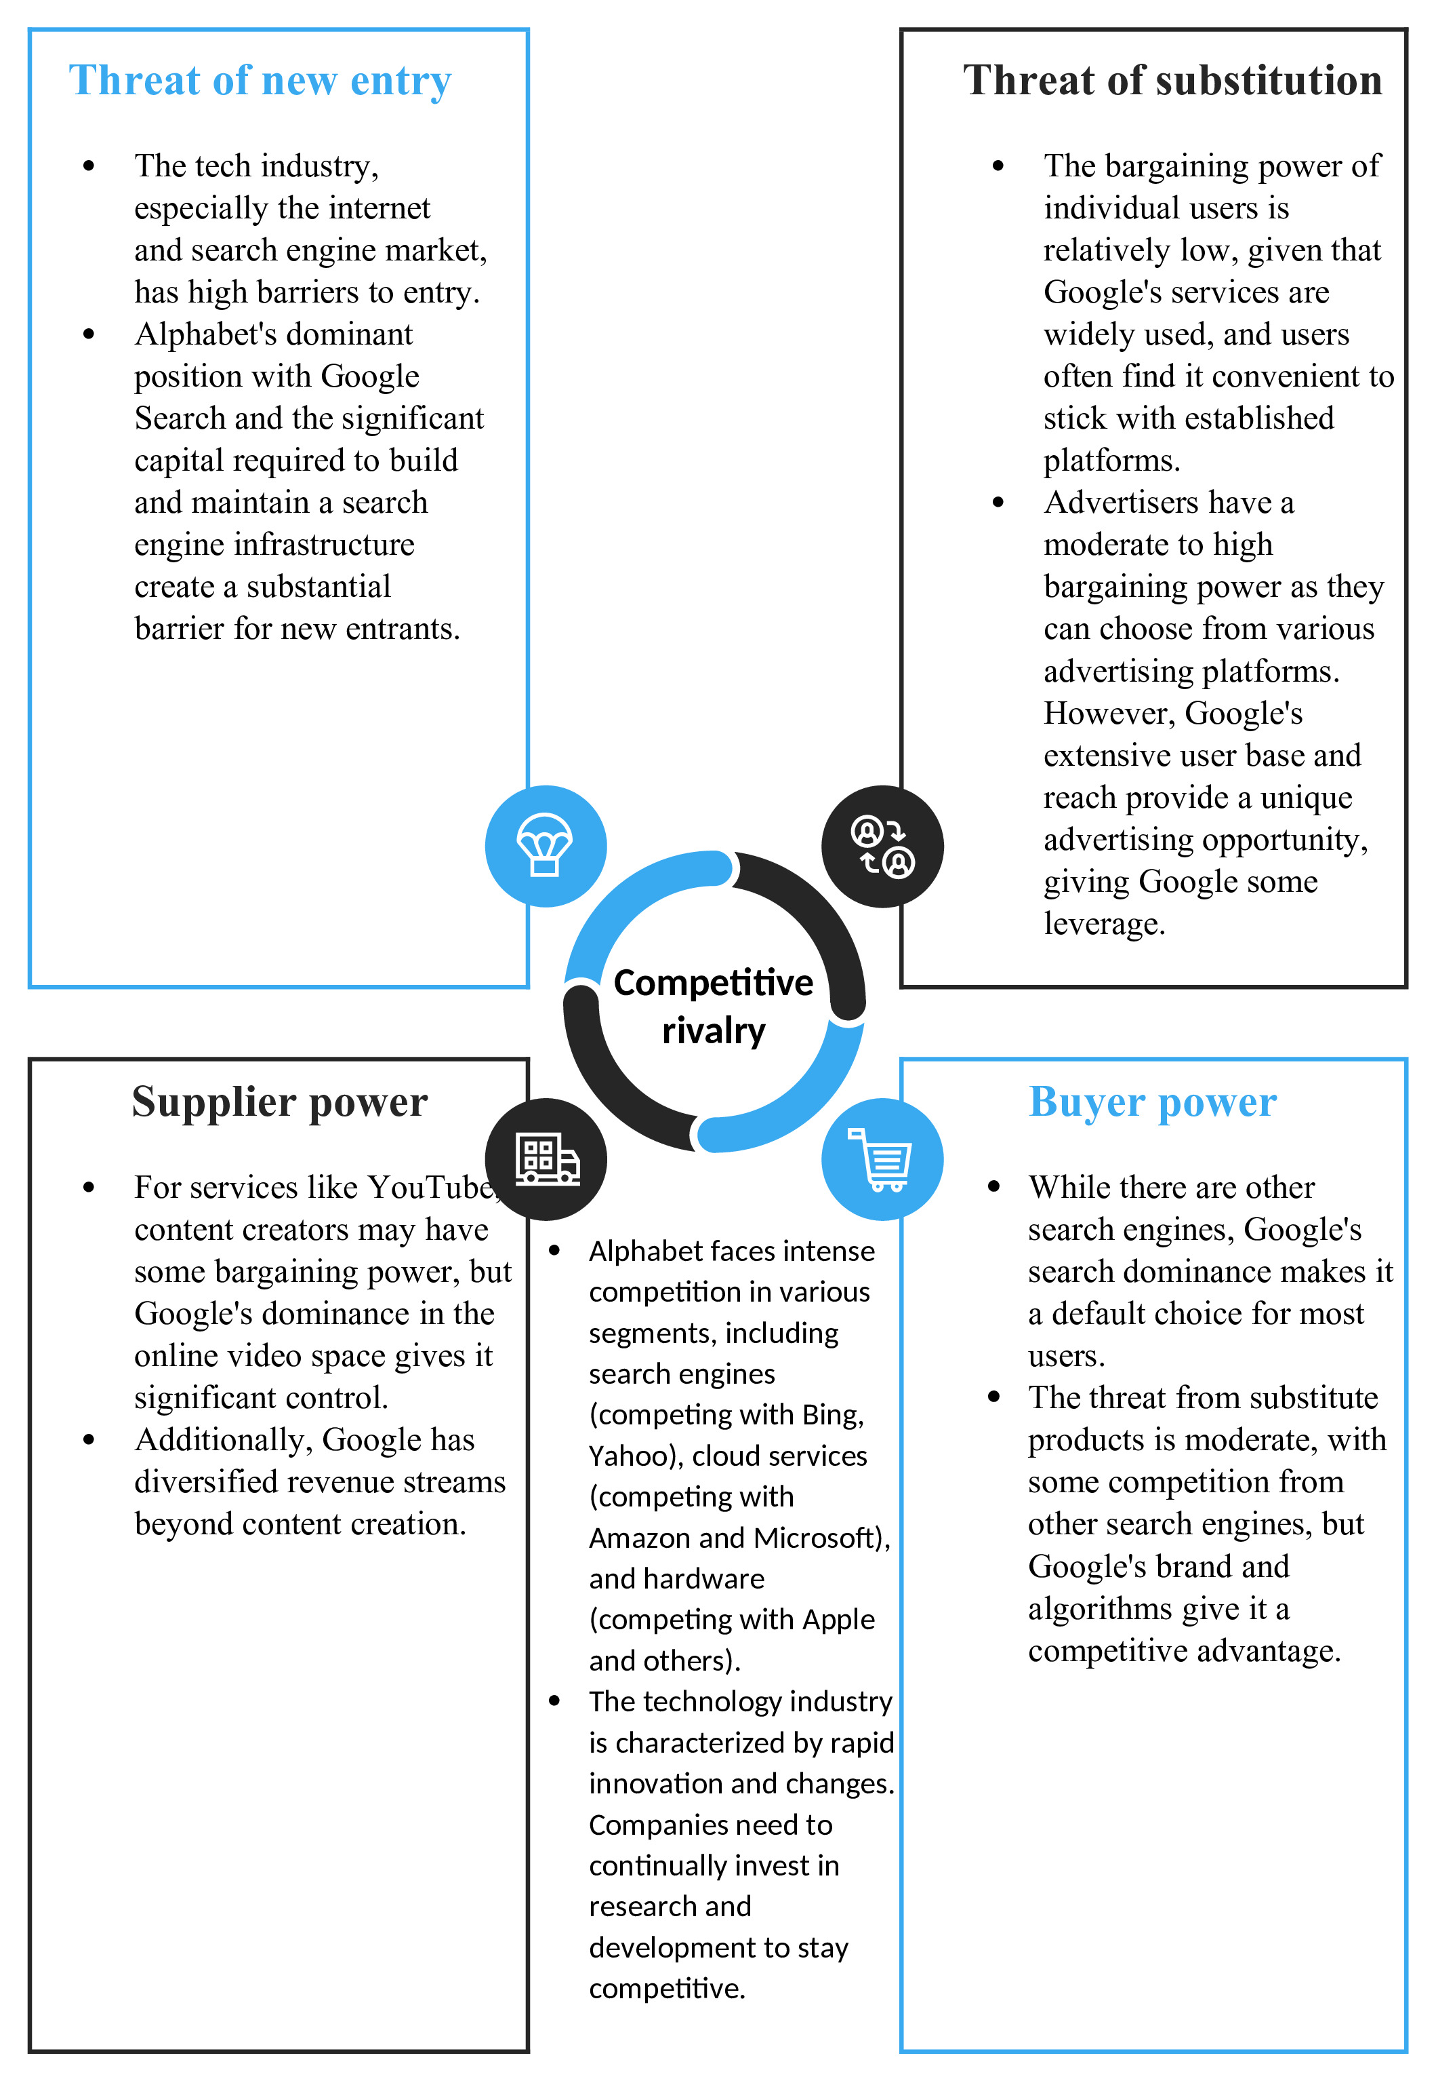
Porter's Five Forces

Slide 23

Recommendations from Firms / Analysts

Slide 24
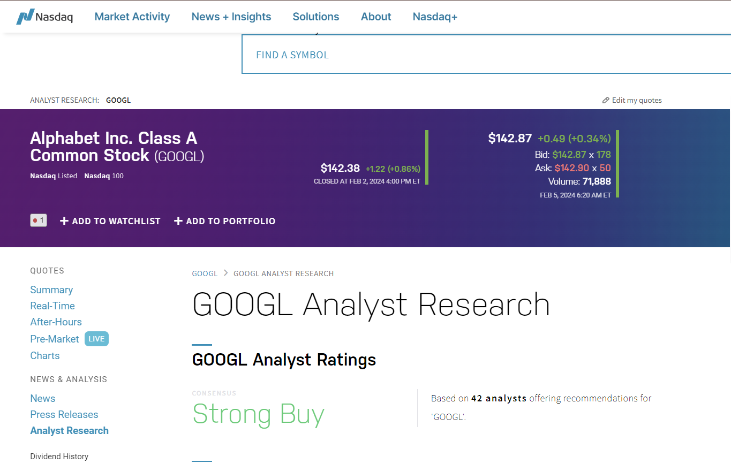

Slide 25
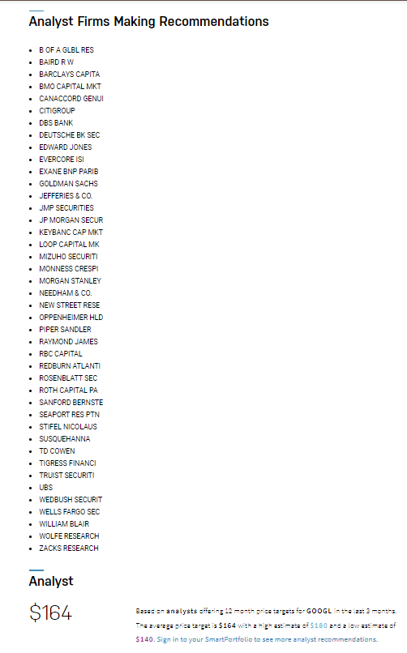
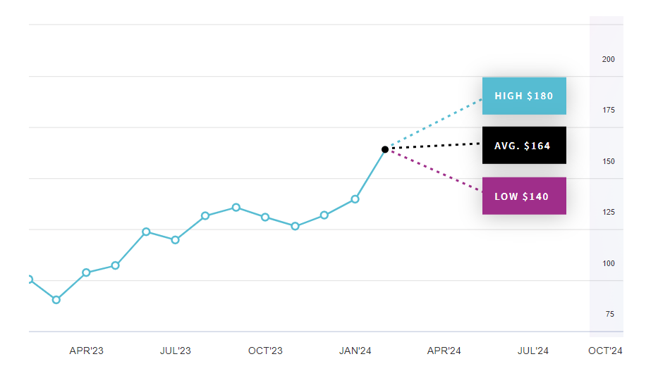
Based on analysts offering 12-month price targets for GOOGL in the last 3 months. The average price target is $164 with a high estimate of $180 and a low estimate of $140.

Slide 26
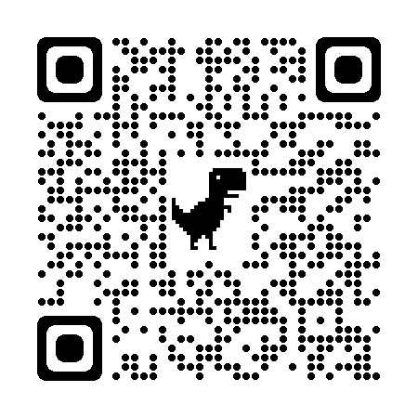

Slide 27

Bibliography

Slide 28
Content Source:
Wikipedia - https://en.wikipedia.org/wiki/Alphabet_Inc.
EDGAR - https://www.sec.gov/ix?doc=/Archives/edgar/data/1652044/000165204423000016/goog-20221231.htm
ALPHABET – abc.xyz
Morningstar/Sustainalytics - https://www.sustainalytics.com/esg-rating/alphabet-inc/1007907342
Stock Analysis - https://stockanalysis.com/analysts/top-stocks/
Porter's 5 forces - custom-writing.org
Image Source:
CBInsights - https://www.cbinsights.com/research/report/industries-disruption-alphabet/
FourWeekMBA - https://fourweekmba.com/how-does-google-make-money/
Business Model Canvas - businessmodelanalyst.com
(Stock Image: source – Google.com)

Slide 29

Thank you..

